Slide 1
Quality Management

Slide 2
Objectives
To introduce the quality management process and key quality management activities
To explain the role of standards in quality management
To explain the concept of a software metric, predictor metrics and control metrics
To explain how measurement may be used in assessing software quality and the limitations of software measurement

Slide 3
Topics covered
Process and product quality
Quality assurance and standards
Quality planning
Quality control

Slide 4
Software quality management
Concerned with ensuring that the required level of quality is achieved in a software product.
Involves defining appropriate quality standards and procedures and ensuring that these are followed.
Should aim to develop a ‘quality culture’ where quality is seen as everyone’s responsibility.

Slide 5
What is quality?
Quality, simplistically, means that a product should meet its specification.
This is problematical for software systems
  There is a tension between customer quality requirements (efficiency, reliability, etc.) and developer quality requirements (maintainability, reusability, etc.);
  Some quality requirements are difficult to specify in an unambiguous way;
  Software specifications are usually incomplete and often inconsistent.

Slide 6
The quality compromise
We cannot wait for specifications to improve before paying attention to quality management.
We must put quality management procedures into place to improve quality in spite of imperfect specification.

Slide 7
Scope of quality management
Quality management is particularly important for large, complex systems. The quality documentation is a record of progress and supports continuity of development as the development team changes.
For smaller systems, quality management needs less documentation and should focus on establishing a quality culture.

Slide 8
Quality management activities
Quality assurance
  Establish organisational procedures and standards for quality.
Quality planning
  Select applicable procedures and standards for a particular project and modify these as required.
Quality control
  Ensure that procedures and standards are followed by the software development team.
Quality management should be separate from project management to ensure independence.

Slide 9
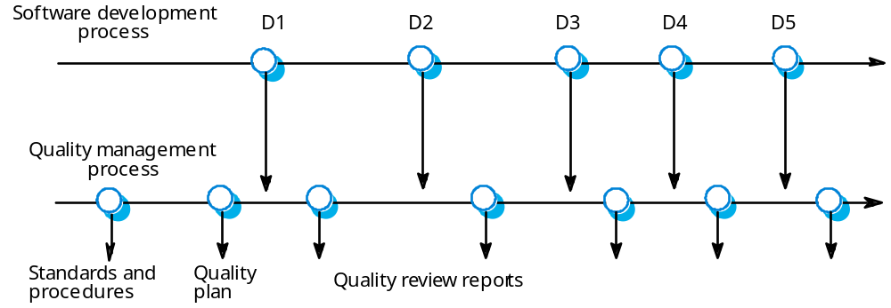
Quality management and software development

Slide 10
Process and product quality
The quality of a developed product is influenced by the quality of the production process.
This is important in software development as some product quality attributes are hard to assess.
However, there is a very complex and poorly understood relationship between software processes and product quality.

Slide 11
Process-based quality
There is a straightforward link between process and product in manufactured goods.
More complex for software because:
  The application of individual skills and experience is particularly important in software development;
  External factors such as the novelty of an application or the need for an accelerated development schedule may impair product quality.
Care must be taken not to impose inappropriate process standards - these could reduce rather than improve the product quality.

Slide 12
Process-based quality

Slide 13
Practical process quality
Define process standards such as how reviews should be conducted, configuration
management, etc.
Monitor the development process to ensure
that standards are being followed.
Report on the process to project management and software procurer.
Don’t use inappropriate practices simply because standards have been established.

Slide 14
Quality assurance and standards
Standards are the key to effective quality management.
They may be international, national, organizational or project standards.
Product standards define characteristics that all components should exhibit e.g. a common programming style.
Process standards define how the software process should be enacted.

Slide 15
Importance of standards
Encapsulation of best practice- avoids
repetition of past mistakes.
They are a framework for quality assurance processes - they involve checking compliance to standards.
They provide continuity - new staff can understand the organisation by understanding the standards that are used.

Slide 16
Product and process standards

Slide 17
Problems with standards
They may not be seen as relevant and up-to-date by software engineers.
They often involve too much bureaucratic form filling.
If they are unsupported by software tools, tedious manual work is often involved to maintain the documentation associated with the standards.

Slide 18
Standards development
Involve practitioners in development. Engineers should understand the rationale underlying a standard.
Review standards and their usage regularly.
Standards can quickly become outdated and this reduces their credibility amongst practitioners.
Detailed standards should have associated tool
support. Excessive clerical work is the most
significant complaint against standards.

Slide 19
ISO 9000
An international set of standards for quality management.
Applicable to a range of organisations from manufacturing to service industries.
ISO 9001 applicable to organisations which design, develop and maintain products.
ISO 9001 is a generic model of the quality process that must be instantiated for each organisation using the standard.

Slide 20
ISO 9001

Slide 21
ISO 9000 certification
Quality standards and procedures should be documented in an organisational quality manual.
An external body may certify that an organisation’s quality manual conforms to ISO 9000 standards.
Some customers require suppliers to be ISO 9000 certified although the need for flexibility here is increasingly recognised.

Slide 22
ISO 9000 and quality management

Slide 23
Documentation standards
Particularly important - documents are the tangible manifestation of the software.
Documentation process standards
  Concerned with how documents should be developed, validated and maintained.
Document standards
  Concerned with document contents, structure, and appearance.
Document interchange standards
  Concerned with the compatibility of electronic documents.

Slide 24
Documentation process

Slide 25
Document standards
Document identification standards
  How documents are uniquely identified.
Document structure standards
  Standard structure for project documents.
Document presentation standards
  Define fonts and styles, use of logos, etc.
Document update standards
  Define how changes from previous versions are reflected in a document.

Slide 26
Document interchange standards
Interchange standards allow electronic documents to be exchanged, mailed, etc.
Documents are produced using different systems and on different computers. Even when standard tools are used, standards are needed to define conventions for their use e.g. use of style sheets and macros.
Need for archiving. The lifetime of word processing systems may be much less than the lifetime of the software being documented. An archiving standard may be defined to ensure that the document can be accessed in future.

Slide 27
Quality planning
A quality plan sets out the desired product qualities and how these are assessed and defines the most significant quality attributes.
The quality plan should define the quality assessment process.
It should set out which organisational standards should be applied and, where necessary, define new standards to be used.

Slide 28
Quality plans
Quality plan structure
  Product introduction;
  Product plans;
  Process descriptions;
  Quality goals;
  Risks and risk management.
Quality plans should be short, succinct documents
  If they are too long, no-one will read them.

Slide 29
Software quality attributes

Slide 30
Quality control
This involves checking the software development process to ensure that procedures and standards are being followed.
There are two approaches to quality control
  Quality reviews;
  Automated software assessment and software measurement.

Slide 31
Quality reviews
This is the principal method of validating the quality of a process or of a product.
A group examines part or all of a process or system and its documentation to find potential problems.
There are different types of review with different objectives
  Inspections for defect removal (product);
  Reviews for progress assessment (product and process);
  Quality reviews (product and standards).

Slide 32
Types of review

Slide 33
Quality reviews
A group of people carefully examine part or all
of a software system and its associated
documentation.
Code, designs, specifications, test plans,
standards, etc. can all be reviewed.
Software or documents may be 'signed off' at a
review which signifies that progress to the next
development stage has been approved by
management.

Slide 34
Review functions
Quality function - they are part of the general quality management process.
Project management function - they provide information for project managers.
Training and communication function - product knowledge is passed between development team members.

Slide 35
Quality reviews
The objective is the discovery of system defects and inconsistencies.
Any documents produced in the process may be reviewed.
Review teams should be relatively small and reviews should be fairly short.
Records should always be maintained of quality reviews.

Slide 36
Review results
Comments made during the review should be
classified
  No action. No change to the software or documentation is
  required;
  Refer for repair. Designer or programmer should correct an identified fault;
  Reconsider overall design. The problem identified in the
  review impacts other parts of the design. Some overall
  judgement must be made about the most cost-effective way of solving the problem;
Requirements and specification errors may
have to be referred to the client.

Slide 37
Software measurement and metrics
Software measurement is concerned with deriving a numeric value for an attribute of a software product or process.
This allows for objective comparisons between techniques and processes.
Although some companies have introduced measurement programmes, most organisations still don’t make systematic use of software measurement.
There are few established standards in this area.

Slide 38
Software metric
Any type of measurement which relates to a software system, process or related documentation
  Lines of code in a program, the Fog index, number of person-days required to develop a component.
Allow the software and the software process to
be quantified.
May be used to predict product attributes or to control the software process.
Product metrics can be used for general predictions or to identify anomalous components.

Slide 39
Predictor and control metrics

Slide 40
Metrics assumptions
A software property can be measured.
The relationship exists between what we can
measure and what we want to know. We can only measure internal attributes but are often more interested in external software attributes.
This relationship has been formalised and
validated.
It may be difficult to relate what can be measured to desirable external quality attributes.

Slide 41
Internal and external attributes

Slide 42
The measurement process
A software measurement process may be part of a quality control process.
Data collected during this process should be maintained as an organisational resource.
Once a measurement database has been established, comparisons across projects become possible.

Slide 43
Product measurement process

Slide 44
Data collection
A metrics programme should be based on a set of product and process data.
Data should be collected immediately (not in retrospect) and, if possible, automatically.
Three types of automatic data collection
  Static product analysis;
  Dynamic product analysis;
  Process data collation.

Slide 45
Data accuracy
Don’t collect unnecessary data
  The questions to be answered should be decided in advance and the required data identified.
Tell people why the data is being collected.
  It should not be part of personnel evaluation.
Don’t rely on memory
  Collect data when it is generated not after a project has finished.

Slide 46
Product metrics
A quality metric should be a predictor of
product quality.
Classes of product metric
  Dynamic metrics which are collected by measurements made of a program in execution;
  Static metrics which are collected by measurements made of the system representations;
  Dynamic metrics help assess efficiency and reliability; static metrics help assess complexity, understandability and maintainability.

Slide 47
Dynamic and static metrics
Dynamic metrics are closely related to software quality attributes
  It is relatively easy to measure the response time of a system (performance attribute) or the number of failures (reliability attribute).
Static metrics have an indirect relationship with quality attributes
  You need to try and derive a relationship between these metrics and properties such as complexity, understandability and maintainability.

Slide 48
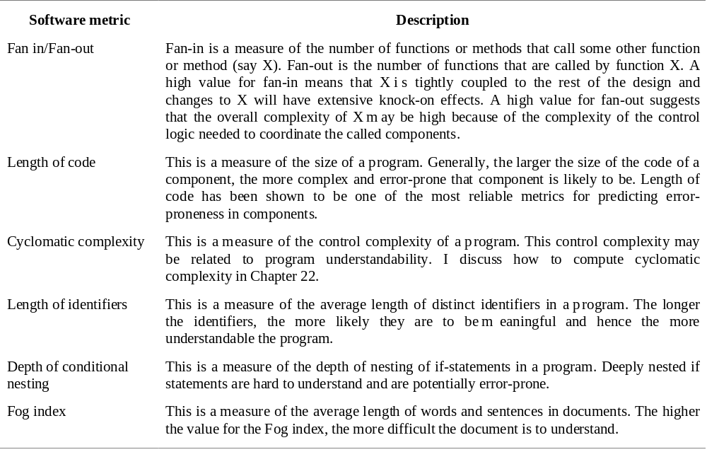
Software product metrics

Slide 49
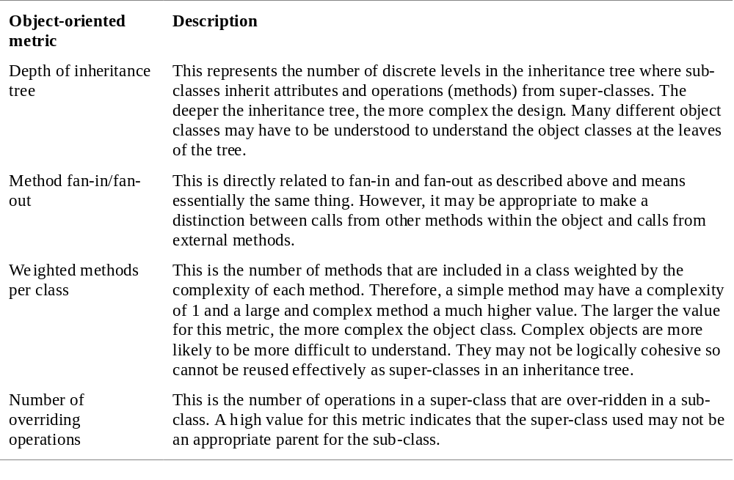
Object-oriented metrics

Slide 50
Measurement analysis
It is not always obvious what data means
  Analysing collected data is very difficult.
Professional statisticians should be consulted if available.
Data analysis must take local circumstances into account.

Slide 51
Measurement surprises
Reducing the number of faults in a program leads to an increased number of help desk calls
  The program is now thought of as more reliable and so has a wider more diverse market. The percentage of users who call the help desk may have decreased but the total may increase;
  A more reliable system is used in a different way from a system where users work around the faults. This leads to more help desk calls.

Slide 52
Key points
Software quality management is concerned with ensuring that software meets its required standards.
Quality assurance procedures should be documented in an organisational quality manual.
Software standards are an encapsulation of best practice.
Reviews are the most widely used approach for assessing software quality.

Slide 53
Key points
Software measurement gathers information about both the software process and the software product.
Product quality metrics should be used to identify potentially problematical components.
There are no standardised and universally applicable software metrics.

